Slide 1
MPLS
Introduction
Module 6

Slide 2
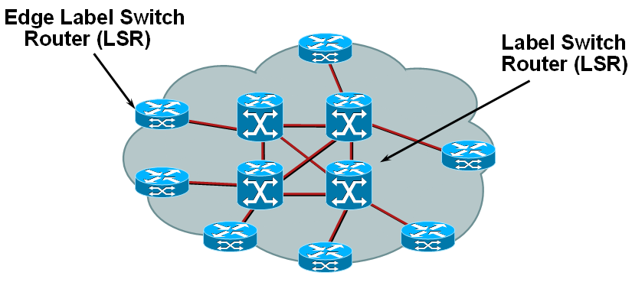
What is MPLS?
MPLS: Multiprotocol Label Switching
  “Multiprotocol Label Switching (MPLS) fuses the intelligence of routing with the performance of switching and provides significant benefits to networks with a pure IP architecture as well as those with IP and ATM or a mix of other Layer 2 technologies.”
  MPLS is a method of gluing connectionless IP to connection-oriented networks.
  MPLS combines the dynamic capabilities of IP and IP routing with performance of Layer 2 switching and Virtual Circuits.
Rick Graziani graziani@cabrillo.edu

Slide 3
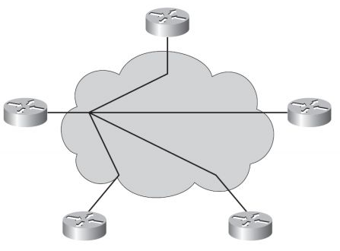
Traditional WAN connections
Hub and Spoke
  Most commonly used model
  Cost effective minimizing number of circuits
    Leased lines
    Access circuits to packet switched networks such as Frame Relay
Rick Graziani graziani@cabrillo.edu

Slide 4
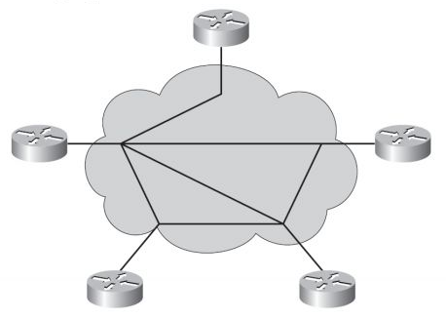
Traditional WAN connections
Partial Mesh
  Allows for the cost effectiveness of hub and spoke, but also allows critical sites to have point-to-point connections
Rick Graziani graziani@cabrillo.edu

Slide 5
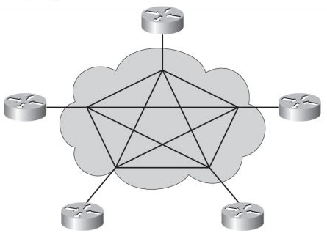
Traditional WAN connections
Full Mesh
  Need advantages of point-to-point links throughout topology
  Circuits = n (n-1) / 2
    n = number of sites
  435 circuits = 30 (30-1)/2
Rick Graziani graziani@cabrillo.edu

Slide 6
Advantages of point-to-point circuits
Less latency
More control
Better performance
Rick Graziani graziani@cabrillo.edu

Slide 7
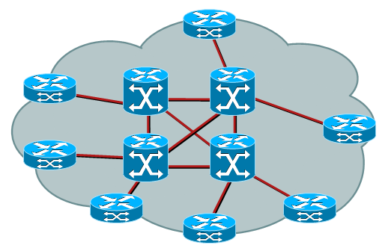
What is the problem MPLS is trying to solve?
Layer 3 End-to-end circuits
  Advantages
    IP routing provides dynamic, automatic path setup
    Provides best path and backup paths
    Provides QoS
  Disadvantages
    Latency in hop-by-hop Layer 3 lookup
    Latency in routing – switching – packet forwarding process
Rick Graziani graziani@cabrillo.edu

Slide 8
What is the problem MPLS is trying to solve?
Layer 2 End-to-end circuits (ATM, Frame Relay)
  Advantages
    Circuits (SVC or PVC) means destinations are pre-established at switches
    Less latency, switched only - no Layer 3 lookups
  Disadvantages
    Circuits difficult to manage - must use management software or human configuration.
    QoS and SLAs are individually managed
Rick Graziani graziani@cabrillo.edu

Slide 9
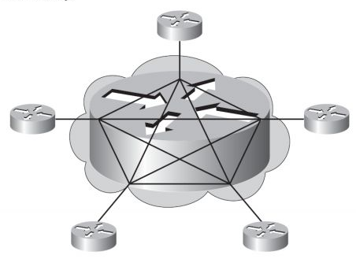
MPLS WAN Connectivity
MPLS extends Layer 3 natively between sites.
The MPLS network although owned by a service provider but is an extension of the enterprise network.
MPLS network is like a single router with multiple interfaces.
Rick Graziani graziani@cabrillo.edu

Slide 10
MPLS WAN Connectivity
MPLS network:
  Converges dynamically
  Supports multiple routing protocols
  Honors QoS traffic tags and policies
MPLS requires only a single connection to provider’s MPLS network.
Rick Graziani graziani@cabrillo.edu

Slide 11




First groups of Terms
Customer A Non-MPLS
Ingress Edge LSR:
Handles packets entering MPLS domain
Label Switch Path (LSP)
Egress Edge LSR:
Handles packets leaving MPLS domain
Label Switch Router (LSR) or P (Provider) router
PE
Customer A Non-MPLS
Customer B Non-MPLS
MPLS domain – A contiguous set of nodes performing MPLS routing and forwarding. These are typically in one routing or administrative domain.
MPLS Node – A node running MPLS. An MPLS node is aware of MPLS control protocols, operates one or more Layer 3 routing protocols, and is capable of forwarding packets based on labels. Optimally, an MPLS node can also forward native Layer 3 packets.
Label Switching Router (LSR) – An MPLS node that is capable of forwarding labeled packets.
Label – A short, fixed-length, physically contiguous identifier used to identify a group of networks sharing a common destination, usually of local significance.
Rick Graziani graziani@cabrillo.edu

Slide 12
First groups of Terms
Customer A Non-MPLS
Ingress Edge LSR:
Handles packets entering MPLS domain
Label Switch Path (LSP)
Egress Edge LSR:
Handles packets leaving MPLS domain
Label Switch Router (LSR) or P (Provider) router
PE
Customer A Non-MPLS
Customer B Non-MPLS
MPLS Edge Node – An MPLS node that connects to a neighboring node outside the MPLS network.
MPLS Ingress Node – An MPLS node that handles traffic entering an MPLS domain.
MPLS Egress Node – An MPLS node that handles traffic leaving an MPLS domain.
Rick Graziani graziani@cabrillo.edu

Slide 13
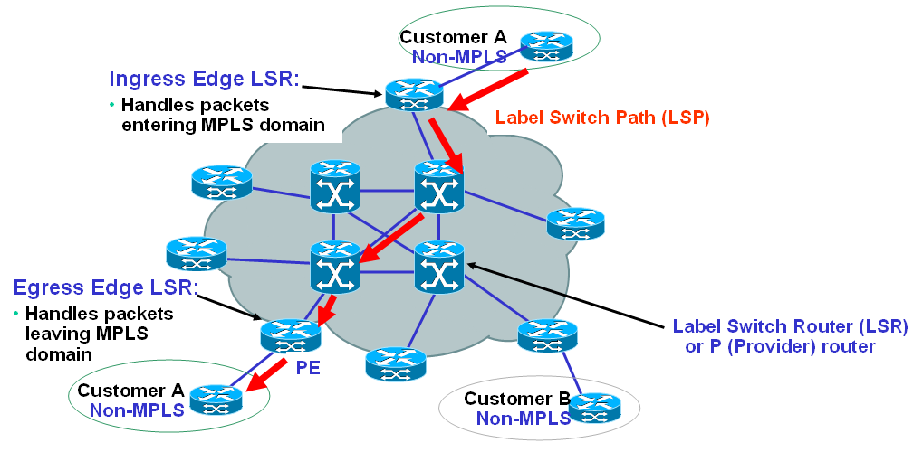
MPLS Features
MPLS is a switching mechanism.
LSRs do label lookup and replacement but need not be capable of Layer 3 routing.
  MPLS Node – A node running MPLS. An MPLS node is aware of MPLS control protocols, operates one or more Layer 3 routing protocols, and is capable of forwarding packets based on labels. Optimally, an MPLS node can also forward native Layer 3 packets.
Rick Graziani graziani@cabrillo.edu

Slide 14

MPLS Features
Traditional Routing
  Router receives packet
  Makes a forwarding decision based on Layer 3 information
    Destination address matches longest match prefix entry in the routing table
    Layer 2 encapsulation is determined
    Layer 2 address (eg ARP) is resolved
  Performs a path switch
  Dispatches the packet to the next-hop router
  Process repeats itself – Every router along the path examines the packet.
Rick Graziani graziani@cabrillo.edu

Slide 15
MPLS Features
MPLS philosophy is that the Layer 3 header contains significantly more information than is necessary to forward the packet.
MPLS - Using Layer 3 routing protocols, build a Layer 3 routing protocol that functions without dependence on individual Layer 3 routed protocols.
MPLS underlying routing process:
  Sort entire sets of possible packets in classes based on the destination address of each known as Forwarding Equivalence Classes (FEC).
    FEC – Different packets that need to be forwarded to the same next-hop (or along the same MPLS path).
  Map each FEC to a next-hop address
Rick Graziani graziani@cabrillo.edu

Slide 16
MPLS Features
MPLS
  Only one examination of the packet
  Only one assignment to the FEC
  This is done at the MPLS ingress node
FEC
  Encoded as a short, fixed-length value known as a label.
  FEC is all packets to which a specific label is attached.
  Could be based on:
    Destination address
    Egress LSR
    CoS (Class of Service)
Label Switch Path (LSP)
  The path through one or more LSRs at one level of the hierarchy followed by a packet in a particular path.
Rick Graziani graziani@cabrillo.edu

Slide 17

MPLS Features
Labels usually correspond to destination networks, similar to Layer 3 routing.
A label does not contain any information about the Layer 3 protocol that is being carried in a packet.
Labels can also correspond to:
  Layer 3 VPN destination
  Layer 2 virtual circuit
  Egress interface
  QoS
  Source address
MPLS designed to forward any type of Layer 3 packet, but IPv4 and IPv6 is at the forefront.
Rick Graziani graziani@cabrillo.edu

Slide 18
Label Format
Field | Description
20-bit label | The actual label. Values 0 to 15 are reserved.
3-bit experimental (EXP) field | Undefined in the RFC. Used by Cisco to define a class of service (CoS) (IP precedence).
1-bit bottom-of-stack indicator | MPLS allows multiple labels to be inserted. The bottom-of-stack bit determines if this label is the last label in the packet. If this bit is set (1), the setting indicates that this label is the last label.
8-bit Time to Live (TTL) field | Has the same purpose as the TTL field in the IP header.
Rick Graziani graziani@cabrillo.edu
Notes:
MPLS labels have a specific format and fields that assist in making forwarding decisions. The 32-bit MPLS label contains four fields.

Slide 19
MPLS Features
Packets are labeled prior to being forwarded at Ingress edge LSR.
After ingress node, there is no routing table lookup.
At each non-edge LSR the label is removed and a new label added at each hop.
Only edge LSRs perform routing table lookups.
Non-edge LSRs perform forwarding process based only on the label, not Layer 3 information.
Decreases latency – faster packet forwarding.
Final edge LSR (egress LSR):
  “pops” (removes) the label from the packet and
  performs a new routing table lookup to forward the packet
Rick Graziani graziani@cabrillo.edu

Slide 20
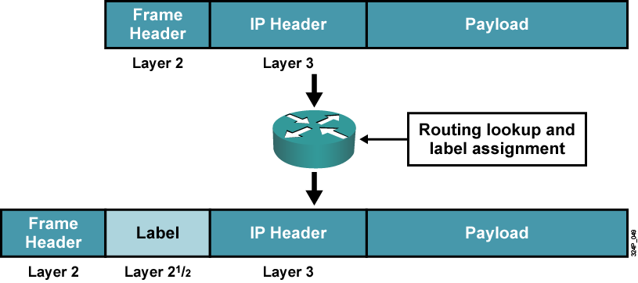
MPLS Features
Note: The type or protocol ID field indicates as MPLS enabled layer-3 protocol.
Rick Graziani graziani@cabrillo.edu
Notes:
This graphic shows an edge router that receives a normal IP packet. The MPLS label is often depicted as a new "shim layer" that has interposed itself between the network and data link layers. This layer is where the term "Layer 2.5 technology" comes from.

Slide 21
MPLS Features
Penultimate hop pop
  When the LSR prior to the destination edge router pops the label before sending the packet to the final edge LSR.
  Final edge router then does not need to perform both a label lookup and a Layer 3 routing lookup, but only the Layer 3 routing lookup.
  More later
Rick Graziani graziani@cabrillo.edu

Slide 22
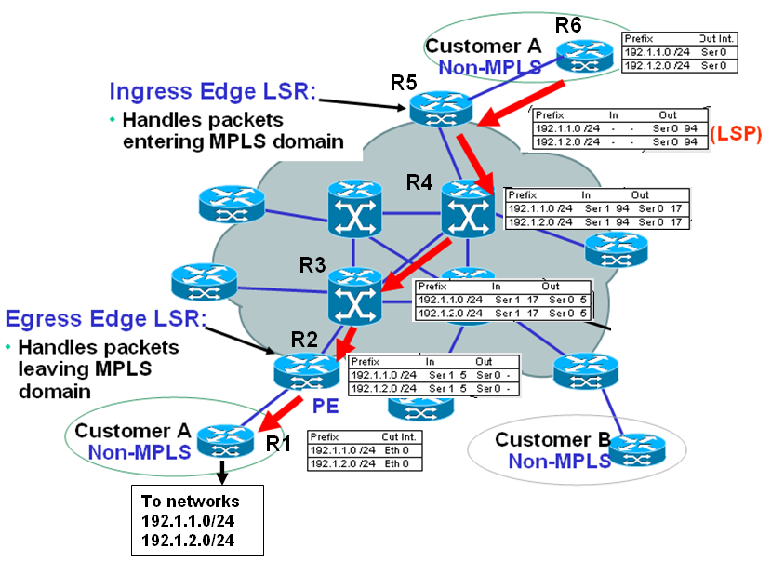
LDP
Label switching and distribution is similar to traditional routing.
EXCEPTION: When the edge LSR adds the label the packet is predestined to arrive at its appropriate end.
Greatly increases efficiency – less latency.
Rick Graziani graziani@cabrillo.edu

Slide 23
LDP
MPLS does add overhead with additional communications between routers.
Label distribution is performed by LDP (Label Distribution Protocol) or known as MPLS-LDP.
Two ways to propagate labels:
  Extend functionality of existing protocols
  Create a new protocol specifically for label exchange (IETF approach)
Rick Graziani graziani@cabrillo.edu

Slide 24
LDP
In MPLS the LSR assigns a particular label to a particular FEC.
The downstream LSR informs the upstream LSR of its label for that FEC.
LSRs know their neighbors through the IP routing protocol
Neighbors:
  R1 is downstream neighbor of R2
  R2 is the downstream neighbor of R3
  Next-hop address is the downstream neighbor
Labels are downstream assigned because routes entries come from the downstream side.
Rick Graziani graziani@cabrillo.edu

Slide 25
LDP
Assuming traffic flows in both directions, label will propagate in both directions.
Split horizon applies to LDP
  An LSR will never advertise an label to a neighbor from whom it was learned.
Two routers that are label distribution peers are said to have a label distribution adjacency between them.
Rick Graziani graziani@cabrillo.edu

Slide 26
Time for an Example
Rick Graziani graziani@cabrillo.edu

Slide 27
R1
The bottom non-MPLS (customer) router has networks 192.1.1.0 /24, 192.1.2.0 /24 somewhere out the FastEthernet 0/0 interface.
  Directly connected or learned from another router.
The table to the right is the routing table, which tracks the routing prefix, the outgoing interface, next hop router, and perhaps other information.
R1 advertises these networks to R2 and the rest of the domain via a dynamic routing protocols such as OSPF.
Rick Graziani graziani@cabrillo.edu

Slide 28
R2
Using LDP, LSR R2 selects a free (unused) label 5, and advertises it to the upstream neighbor. (This is usually a reserved label.)
The hyphen in the Out column is intended to note that all labels are to be popped (removed) in forwarding to the non-LSR below.
Thus, a frame received on Serial 1 with label 5 is to be forwarded out Serial 0 with no label.
Rick Graziani graziani@cabrillo.edu

Slide 29
R3
LSR R3 has learned routes to the two prefixes we're tracking.
  R3 advertises the routes upstream.
When LDP information is received, R3 records use of label 5 on outgoing interface Serial 0 for the two prefixes we're tracking.
R3 then allocates label 17 on Serial 1 for this FEC, and uses LDP to communicate this to the upstream LSR.
Thus, when label 17 is received on Serial 1, it is replaced with label 5 and the frame sent out Serial 0.
Rick Graziani graziani@cabrillo.edu

Slide 30
R4
LSR R4 has learned routes to the two prefixes we're tracking.
  R4 advertises the routes upstream.
When LDP information is received, R4 records use of label 17 on outgoing interface Serial 0 for the two prefixes we're tracking.
R4 then allocates label 94 on Serial 1 for this FEC, and uses LDP to communicate this to the upstream LSR.
Thus, when label 94 is received on Serial 1, it is replaced with label 17 and the frame sent out Serial 0.
Rick Graziani graziani@cabrillo.edu

Slide 31
R5
LSR R5 has learned routes to the two prefixes we're tracking.
When LDP information is received, R5 records use of label 94 on outgoing interface Serial 0 for the two prefixes we're tracking.
Note that there will be no labels sent by the top Ingress Edge LSR.
Because the top router, R6, is not an MPLS participant.
Thus, when IP packet destined for one of these two prefixes, it is a label o f 94 is added and the frame sent out Serial 0.
The red arrows shows the Label Switch Path (LSP) that has now been established.
Rick Graziani graziani@cabrillo.edu

Slide 32


R6 – Layer 3 Routed
R5 – MPLS Switched
94
R4 – MPLS Switched
94
17
R3 – MPLS Switched
17
5
R1 – Layer 3 Routed
R2 – MPLS Switched (popped)
Note: Label allocation, label imposing, label swapping, and label popping usually happen in the service provider network, not the customer (enterprise) network. Customer routers never see a label.
5
Rick Graziani graziani@cabrillo.edu

Slide 33
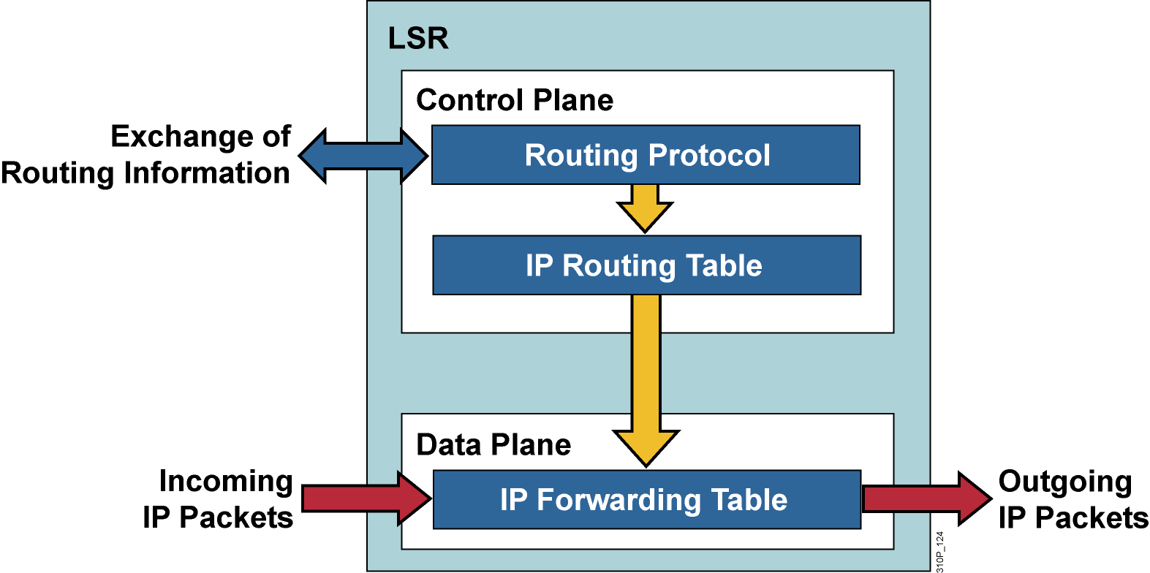
Control and Data Planes
LSRs funtion at both the control and data planes.
Control plane
  Where exchange of routing information takes place
  Traditional routing functions associated with routing protocol operations
  Process routing protocol updates as they occur
Data plane or Forwarding plane
  Where the actual forwarding occurs
  MPLS – This is done solely based on labels.
LSR
  Maintains converged routing table but usually not engaged for packet forwarding
  Maintains routing table to ensure the FIB is up to date with the most current information so that labels can be properly assigned and packets can be dispatched.
Rick Graziani graziani@cabrillo.edu

Slide 34
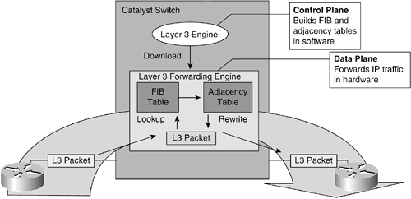


CEF
Routing Table
CEF is a topology driven technology.
Makes use of a FIB (Forwarding Information Base)
  Copy of the Routing table
When a change occurs to the routing table, the FIB is updated.
CEF maintains an adjacency table for Layer 2 next-hop and encapsulation information.
Adjacencies (Layer 2) are linked to the FIB, eliminating the need for ARP requests.
Enabling CEF on Internet facing interfaces can be resource intensive:
  Over 200,000 routes
  Processing and memory intensive
Rick Graziani graziani@cabrillo.edu

Slide 35
MPLS Architecture
FIB (Forwarding Information Base)
  Copy of Routing Table, including labels for MPLS interfaces
  Used to:
    Forward Layer 3 packets (non-MPLS)
    Will add the label for outgoing MPLS interface
    Populate LFIB (MPLS packets)
LIB (Label Information Base)
  Labels learned via LDP are stored and bound to interfaces
    Used to populate LFIB
  Locally assigned and locally significant labels are stored in LIB
  LSR announces its assigned labels to its adjacent peers
  Peers use received label information to associate next-hop label information with network destinations.
LFIB (Label Forwarding Information Base)
  Label Routing table
  Contains IP forwarding information from FIB
  Contains label information from LIB
Rick Graziani graziani@cabrillo.edu

Slide 36
MPLS Architecture
Control plane
Routing updates from other routers
routing protocols database
IP routing table (RIB)
Label bindings learned via LDP from other routers
Label Information Base (LIB)
Data plane
Incoming IP Packet
IP forwarding table (FIB)
Incoming MPLS Packet
Label forwarding table (LFIB)
Outgoing MPLS/IP Packet
Population of RIB/FIB/LIB/LFIB in an MPLS router
Rick Graziani graziani@cabrillo.edu

Slide 37
Label Allocation in a Frame Mode MPLS Environment
Label allocation and distribution in a frame mode MPLS network follows these steps:
  IP routing protocols build the IP routing table.
  Each LSR independently assigns a label to every destination in the IP routing table.
  LSRs announce their assigned labels to all other LSRs.
  Every LSR builds LIB, LFIB, and FIB data structures based on the received labels.
Note: Label allocation, label imposing, label swapping, and label popping usually happen in the service provider network, not the customer (enterprise) network. Customer routers never see a label.
Rick Graziani graziani@cabrillo.edu
Notes:
There are four steps for label allocation and distribution in a Unicast IP routing network and MPLS functionality, including label allocation and distribution. The following steps detail what happens:
The routers exchange information using standard or vendor-specific Interior Gateway Protocol (IGP), such as OSPF, IS-IS, and EIGRP.
Local labels are generated. One locally unique label is assigned to each IP destination that is found in the main routing table and stored in the Label Information Base (LIB) table.
Local labels are propagated to adjacent routers, where these labels might be used as next-hop labels (stored in the Forwarding Information Base [FIB] and LFIB tables to enable label switching).
Every LSR builds its LIB, LFIB, and FIB data structures based on received labels.
These data structures contain label information:
The LIB, in the control plane, is the database that LDP uses. This database is where an IP prefix is assigned a locally significant label that is mapped to a next-hop label that has been learned from a downstream neighbor.
The LFIB, in the data plane, is the database used to forward labeled packets. Local labels, previously advertised to upstream neighbors, are mapped to next-hop labels, previously received from downstream neighbors.
The FIB, in the data plane, is the database used to forward unlabeled IP packets. A forwarded packet is labeled if a next-hop label is available for a specific destination IP network. Otherwise, a forwarded packet is not labeled.

Slide 38
Label Switch Routers: Architecture of LSRs
LSRs, regardless of the type, perform these functions:
    Exchange routing information
    Exchange labels
    Forward packets or cells
  The first two functions are part of the control plane.
  The last function is part of the data plane.
Rick Graziani graziani@cabrillo.edu

Slide 39
Label Switch Routers:
Exchanging Routing updates
In
Label
Address
Prefix
Out
I’face
Out
Label
In
Label
Address
Prefix
Out
I’face
Out
Label
In
Label
Address
Prefix
Out
I’face
Out
Label
128.89
1
128.89
0
128.89
0
171.69
1
171.69
1
…
…
…
…
…
…
0
128.89
1
0
You Can Reach 128.89 Thru Me
You Can Reach 128.89 and 171.69 Thru Me
1
Routing Updates (OSPF, EIGRP, …)
You Can Reach 171.69 Thru Me
171.69
Rick Graziani graziani@cabrillo.edu

Slide 40
Label Switch Routers:
Exchanging and Assigning Labels
In
Label
Address
Prefix
Out
I’face
Out
Label
In
Label
Address
Prefix
Out
I’face
Out
Label
In
Label
Address
Prefix
Out
I’face
Out
Label
-
128.89
1
4
4
128.89
0
9
9
128.89
0
-
-
171.69
1
5
5
171.69
1
7
…
…
…
…
…
…
…
…
…
…
…
…
0
128.89
1
0
Use Label 9 for 128.89
Use Label 4 for 128.89 and
Use Label 5 for 171.69
1
Label Distribution Protocol
Use Label 7 for 171.69
171.69
In Label is the local label generated by the LSR
Out Label is the remote label advertised by the adjacent LSR, which is the IGP next hop
Rick Graziani graziani@cabrillo.edu

Slide 41
Label Switch Routers:
Forwarding Packets
In
Label
Address
Prefix
Out
I’face
Out
Label
In
Label
Address
Prefix
Out
I’face
Out
Label
In
Label
Address
Prefix
Out
I’face
Out
Label
-
128.89
1
4
4
128.89
0
9
9
128.89
0
-
-
171.69
1
5
5
171.69
1
7
…
…
…
…
…
…
…
…
…
…
…
…
0
128.89
1
0
128.89.25.4
Data
9
128.89.25.4
Data
1
128.89.25.4
Data
4
128.89.25.4
Data
Label imposition
of 4
Label swapping
4->9
Label Popping
Rick Graziani graziani@cabrillo.edu

Slide 42
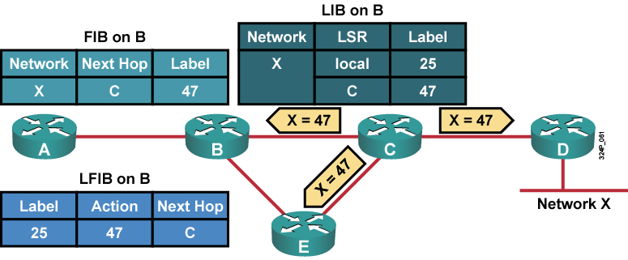
FIB, LIB and LFIB Tables on Router B
Rick Graziani graziani@cabrillo.edu
Notes:
An IGP populates the routing tables in all routers in an MPLS domain. The LDP propagates labels for these networks. Each router determines the router’s own shortest path using an IGP.
The LFIB table is populated by indicating the action that should occur when forwarding the packet based on labels. This action might be to swap a label, remove the label (un-tag), add an outgoing label, or to “pop” the label.
The LDP adds labels into the FIB and LFIB tables. Only those labels that come from the next-hop router are inserted into the outgoing field in the LFIB table.
Router B first assigns label 25 locally to network X and then receives label 47 from the upstream router. Its LFIB table can be completed for network X by inserting 47 as the outgoing label.
In this example label distribution occurs from right to left, and packet forwarding occurs from left to right.

Slide 43
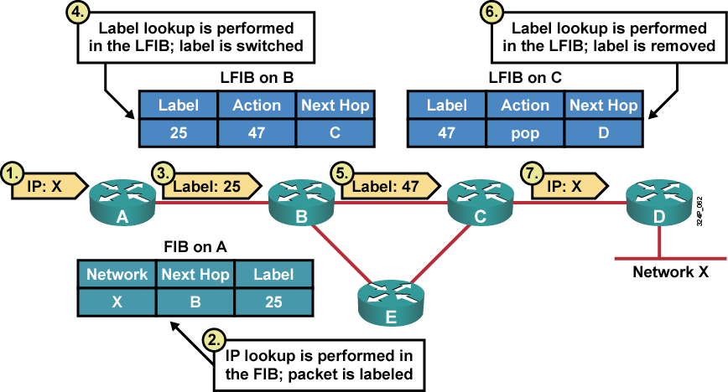
Packet Propagation Across an MPLS Network
Rick Graziani graziani@cabrillo.edu
Notes:
How a packet is forwarded depends on whether the packet is an IP packet or labeled packet. An incoming IP packet is forwarded by using the FIB table and can be sent out as an IP packet or as a labeled IP packet. An incoming labeled packet is forwarded by using the LFIB table and sent out as a labeled IP packet. If a router does not receive a label from the next-hop router, the label is removed and an unlabeled IP packet is sent.
This graphic illustrates how IP packets are propagated across an MPLS domain. The steps are as follows:
An IP packet destined for Network X arrives at Router A.
Router A labels a packet destined for Network X by using the next-hop label 25 (CEF switching by using the FIB table).
Router A sends the packet toward Network X with the MPLS label 25.
Router B swaps label 25 with label 47 using the LFIB.
Router B forwards the packet to Router C (label switching by using the LFIB table).
Router C removes (pops) the label.
Router C forwards the unlabeled packet to Router D (label removed by using the LFIB table).
When a router receives an IP packet, the lookup done is an IP lookup. In Cisco IOS, this means that the packet is looked up in the CEF table. When a router receives a labeled packet, the lookup is done in the LFIB table of the router. The router knows that it receives a labeled packet or an IP packet by looking at the protocol field in the Layer 2 header. If a packet is forwarded by either Cisco Express Forwarding (CEF) (IP lookup) or by LFIB (label lookup), the packet can leave the router either labeled or unlabeled.

Slide 44
MPLS Labels: Penultimate Hop Popping
The label at the top of the stack is removed (popped) by the upstream neighbor of the egress LSR
The egress LSR requests the “popping” through the label distribution protocol
  Egress LSR advertises implicit-null label
One lookup is saved in the egress LSR
Rick Graziani graziani@cabrillo.edu

Slide 45

Example : Penultimate Hop Popping
In
I/F
In
Lab
Address
Prefix
Out
I/F
Out
Lab
In
I/F
In
Lab
Address
Prefix
Out
I/F
Out
Lab
Address
Prefix and mask
Next-Hop
Interface
0
-
171.68/16
1
4
0
4
171.68/16
1
pop
171.68.10/24
171.68.9.1
Serial1
Next-Hop
Next-Hop
171.68.44/24
171.68.12.1
Serial2
...
...
...
...
...
...
...
...
...
...
171.68/16
...
Null
Egress LSR
1
0
1
0
1
0
2
Use label 4 for
FEC 171.68/16
Use label “implicit-null”
for FEC 171.68/16
171.68.44/24
Summary route is propagate through
the IGP and label is assigned by each
LSR
Egress LSR summarises more
specific routes and advertises
a label for the new FEC
171.68.10/24
  Egress LSR needs to do an IP lookup for finding more specific route
  Egress LSR does NOT need to receive a labelled packet
    label will have to be popped anyway
Rick Graziani graziani@cabrillo.edu

Slide 46
Example : Penultimate Hop Popping (contd.)
In
I/F
In
Lab
Address
Prefix
Out
I/F
Out
Lab
In
I/F
In
Lab
Address
Prefix
Out
I/F
Out
Lab
Address
Prefix and mask
Next-Hop
Interface
0
-
171.68/16
1
4
0
4
171.68/16
2
pop
171.68.10/24
171.68.9.1
Serial1
...
...
Next-Hop
Next-Hop
171.68.44/24
171.68.12.1
Serial2
...
...
...
...
...
...
...
...
171.68/16
...
Null
Egress LSR
1
0
1
0
Label = 4
IP packet
D=171.68.10.15
IP packet
D=171.68.10.15
IP packet
D=171.68.10.15
IP packet
D=171.68.10.15
171.68.44/24
171.68.10/24
IP packet enters the MPLS network
Ingress LSR assign a label and
forward the packet
Packet is MPLS forwarded,
label is removed
Packet arrives without the label
at the egress LSR.
Egress LSR only needs to do an IP lookup to match more specific routes
Rick Graziani graziani@cabrillo.edu

Slide 47
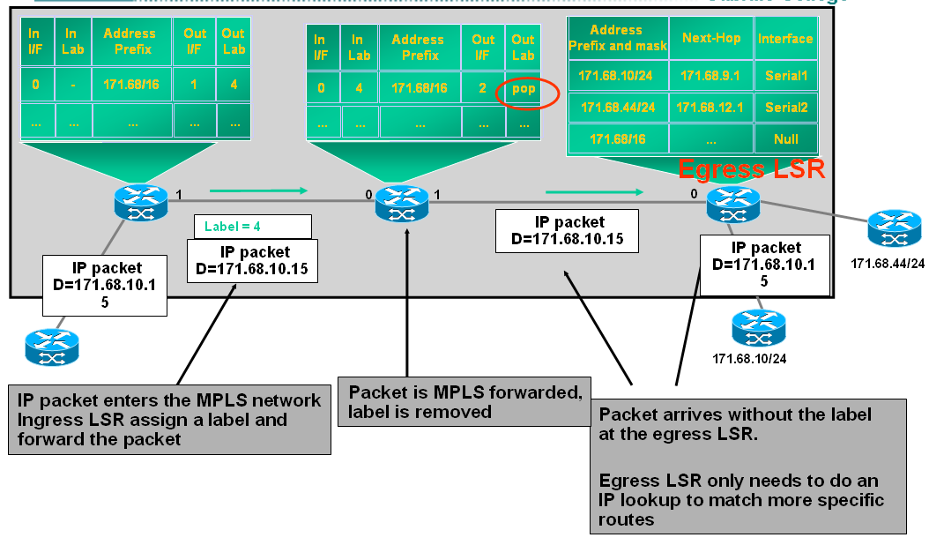
Penultimate Hop Popping (PHP)
PHP optimizes MPLS performance by reducing CPU effort on Edge LSRs.
The Edge LSR advertises a pop or implicit null label (value of 3) to a neighbor.
The pop tells the neighbor to use PHP.
Rick Graziani graziani@cabrillo.edu
Notes:
Using Penultimate Hop Popping (PHP), an LSR removes the outermost label of an MPLS-tagged packet before passing the packet to an adjacent Edge LSR. The process reduces the load on the Edge LSR. Implementing PHP in networks that offer certain quality of service (QoS) features takes careful consideration, and consequently only certain routers in an MPLS-enabled network perform the task. For example, egress routers at the edge of the MPLS network would not use PHP.
Without PHP, the Edge LSR would have to perform at least two label lookups:
The outer label: This label indicates that the packet was destined to have the label stripped on this router.
The inner label: This label identifies which Virtual Routing/Forwarding (VRF) instance to use for the subsequent IP routing lookup
PHP reduces the CPU load on the Edge LSR by distributing work among the Edge LSR’s neighbor routers.
PHP improves MPLS performance by eliminating routing lookups on egress LSRs and optimizes MPLS performance by reducing the number of table lookups on the egress router.
When the downstream router realizes that the router is the final node in the label switched path (LSP), the router can distribute the label value of 3 to the upstream router at the time the path is established. The upstream router makes the next-hop determination for the packet based on the inbound label that the router receives. The router then forwards the packet without a label, allowing the downstream node to perform a single lookup.

Slide 48
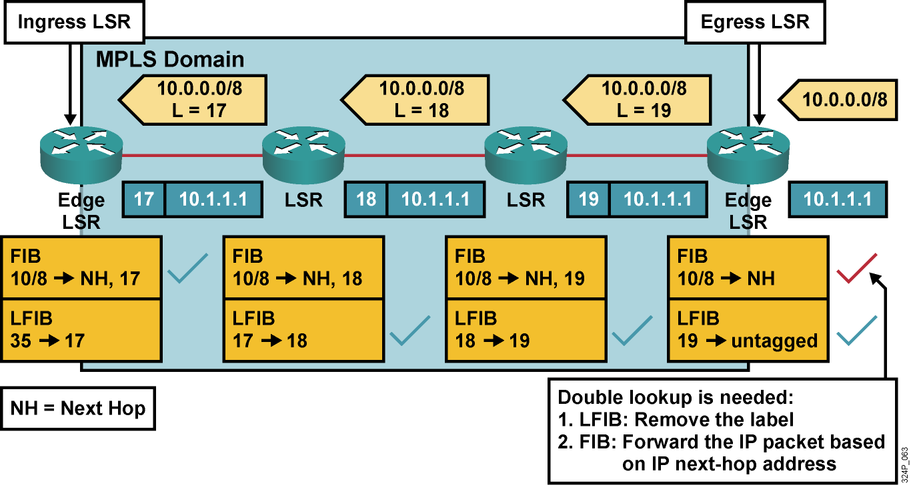
MPLS Without PHP
A double lookup is required.
Rick Graziani graziani@cabrillo.edu
Notes:
This graphic shows how labels are propagated and used in a typical frame mode MPLS network without PHP enabled.
The check marks show which tables are used on individual routers. The egress router in this example must perform a lookup in the LFIB table to determine whether the label must be removed and if a further lookup in the FIB table is required. PHP removes the requirement for a double lookup to be performed on egress LSRs.

Slide 49
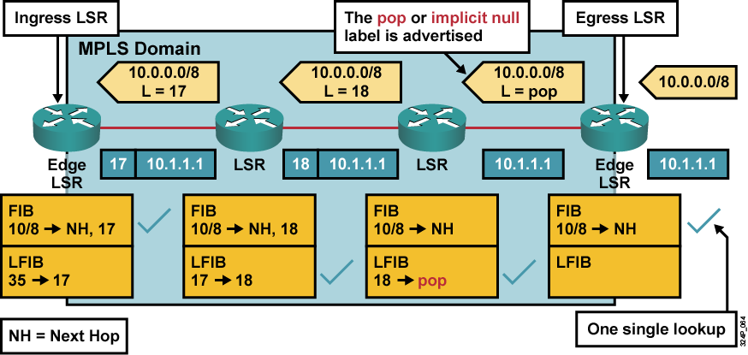
MPLS with PHP
A
B
C
D
A label is removed on the router that is located before the last hop within an MPLS domain (the penultimate router).
Rick Graziani graziani@cabrillo.edu
Notes:
The term pop means to remove the top label in the MPLS label stack instead of swapping the top label with the next-hop label. When popping, the last router before the egress router removes the top label.
This graphic shows how a predefined label pop, which corresponds to the pop action in the LFIB, is propagated on the first hop or the last hop, depending on the perspective. The following is a step-by-step explanation:
IP packet enters the MPLS cloud at Router A, the Ingress LSR;
A FIB lookup is performed and the packet is labeled with 17, the next hop;
The pack travels to Router B an LFIB lookup is performed and the label is switched to Label: 18, which is the next hop to Router C;
Router C does an LFIB lookup and removes (that is, pops) the label;
Router C sends the packet to router D, the Egress LSR.
PHP slightly optimizes MPLS performance by eliminating one LFIB lookup at the egress edge LSR.

